Slide 1
What Is Science (Part 2)
Quantitatve Observation

Slide 2

Observation
Science begins with careful observation.
Looking with a plan and prior knowledge
Looking to see what is actually there (not what you think should be there)
There are two types of observation in science.
Qualitative Observation (think quality)
Observing with your senses (e.g. sight, feel, etc.)
Quantitative Observation (think quantity)
Measuring with devices (e.g. ruler, scale, etc.)

Slide 3
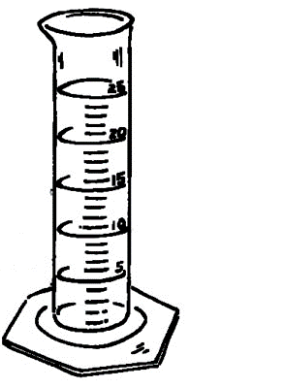
Quantitative Observation
Measured or calculated using lab equipment
Time (in seconds), using a stopwatch
Length (in cm), using a ruler
Mass (in grams), using a balance
Volume (in ml), using a graduated cylinder
Volume (in cm³), calculated = LxWxH
Carefully recording basic measurements
In a Data Table that is neat and well organized
Using multiple trials to minimize measurement errors
Calculated using other basic measurements
For example: Density (in g/cm³) = mass ÷ volume

Slide 4
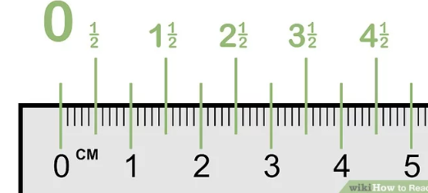
Measuring Length & Distance
Length is a measurement of the size of an object
We measure length using a ruler or meter stick
Width & Height are different names for length
We measure length in centimeters (cm) and millimeters (mm)
1 cm = 10 mm
The length of the arrow is 3.5 cm
Distance is the measurement of the movement of an object
We measure distance in meters (m)
1 m = 100 cm
1 m = 1000 mm

Slide 5
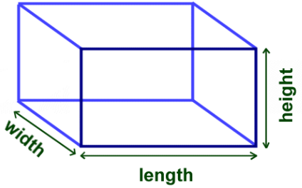
Calculated & Measured Volume
Volume may be calculated using a formula
Volume = L x W x H
The unit for calculated volume is cm³
Volume may be measured using a graduated cylinder
The unit for measured volume in milliliter (ml)
1 ml = 1cm³
Larger volumes are measured in liters (L)
1 L = 1000 ml
1 L = 1000 cm³

Slide 6
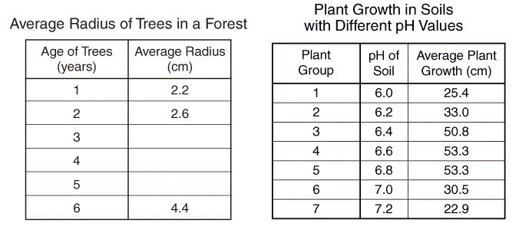
Recording Quantitative Measurements
Use a Data Table to record your measurements
Neatly organized and formatted using a ruler
Make sure to include a descriptive title
Column headings should include
Clear description of what is being measured
Units (e.g. cm) for the measurement
New Row for each different object being measured
Descriptive Column Headings
New Row
For Each
Object

Slide 7
Recording Quantitative Measurements
Copy the following Data Table into your note
Calculate the volume for each object
Object | Length Measurement (± 0.1 cm) | Width Measurement (± 0.1 cm) | Height Measurement (± 0.1 cm) | Volume Calculation (LxWxH cm³)
Object #1 | 2.3 | 3.7 | 1.5
Object #2 | 2.2 | 3.5 | 1.6
Object #3 | 2.4 | 3.6 | 1.7

Slide 8
Recording Quantitative Measurements
Copy the following Data Table into your note
Calculate the volume for each object
Object | Length Measurement (± 0.1 cm) | Width Measurement (± 0.1 cm) | Height Measurement (± 0.1 cm) | Volume Calculation (LxWxH cm³)
Object #1 | 2.3 | 3.7 | 1.5 | 12.8
Object #2 | 2.2 | 3.5 | 1.6 | 12.3
Object #3 | 2.4 | 3.6 | 1.7 | 14.7

Slide 9
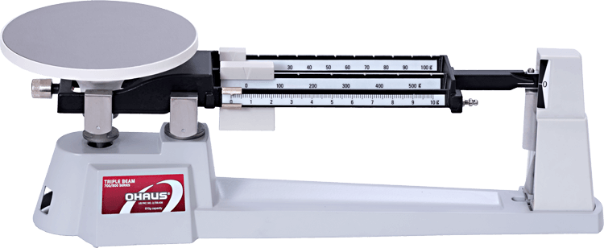
Measuring Mass
Mass is a measurement of the size of an object
We measure mass using a triple beam balance
For small objects we measure mass in grams (g)
For large objects we measure mass in kilograms (Kg)
1 Kg = 1000 g
Weight is NOT the same as mass!
Weight depends on gravity
Your weight changes depending on where your are
You weigh less on the Moon than on Earth
You can be weightless in space
Your mass never changes!
Mass depend on the amount of atoms in your body

Slide 10
Using A Triple Beam Balance
Sliding Weights – Three Beams
10 g weight – adjusts 0g to 100g
100 g weight – adjusts 0g to 500g
1 g weight – adjusts 0g to 10g
Zero Pointer
Objective is to make it zero
If too high: Need to increase sliding weight
If too low: Need to decrease sliding weight
Initial Calibration
Set all the weights to zero
With nothing on the balance
Make sure the Zero Pointer is at zero
If not zero, call your teacher
Zero Pointer
Sliding Weights

Slide 11
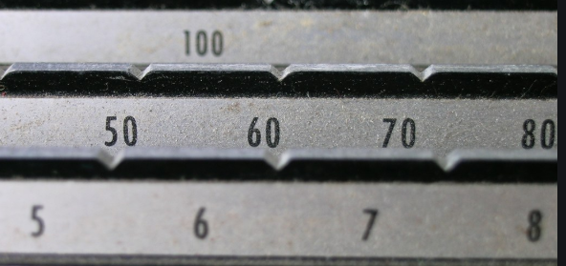
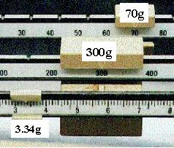
Reading A Triple Beam Balance
Slots
Important Note
Make sure the weights fit in the slots
Do not slide weights between slots
Procedure
Adjust the 100g weight first
Adjust he 10g weight second
Fine tune the zero pointer using the 1g weight
Use a pencil to help make small movements
Add up the sliding weights
The diagram shows a mass of
mass = 300g + 70g + 3.34g
mass = 373.34g

Slide 12
Recording Multiple Trials
We always repeat measurements at least three times
To reduce measurement errors due to equipment
To look for outliers (very high or very low measurements)
We calculate the average
Average = (value1 + value2 + value3) / 3
Copy The following table & Calculate the average
Object | Trial 1 (± 0.1 g) | Trial 1 (± 0.1 g) | Trial 1 (± 0.1 g) | Average (± 0.1 g)
Object #1 | 10.3 | 10.7 | 10.1
Object #2 | 101.4 | 110.3 | 98.7

Slide 13
Recording Multiple Trials
We always repeat measurements at least three times
To reduce measurement errors due to equipment
To look for outliers (very high or very low measurements)
We calculate the average
Average = (value1 + value2 + value3) / 3
Copy The following table & Calculate the average
Object | Trial 1 (± 0.1 g) | Trial 1 (± 0.1 g) | Trial 1 (± 0.1 g) | Average (± 0.1 g)
Object #1 | 10.3 | 10.7 | 10.1 | 10.4
Object #2 | 101.4 | 110.3 | 98.7 | 103.5

